Slide 1

OS24: ONLINE SAFETY 2024

Slide 2

Online Statistics
Average Screen Time: UK teenagers, especially those aged 13-17, spend substantial time online. Ofcom reports that teenagers average about 3-4 hours a day on smartphones, with significant time spent on social media platforms like TikTok, Instagram, and Snapchat. A UK Parliament inquiry also noted that recreational screen time of over 2 hours daily has negative effects on teenagers’ cognitive functions, such as working memory and attention span.

Slide 3
Online Statistics
Social Media: YouTube remains a dominant platform, used by 88% of children aged 3-17, while TikTok has surged, used by around 53% of teenagers. Snapchat also sees high usage with around 46% of young people engaging with the platform.
Content Consumption: Teens prefer short-form, dramatic videos. These are typically low-effort but highly stimulating, often involving themes like gossip or challenges. Many teenagers engage in split-screening, a behavior where they watch multiple videos simultaneously.

Slide 4
Online Statistics
Gaming and Video: Around 80% of older teens (16-17 years) watch live-streamed content, with video games also a major activity for this demographic.

Slide 5
Online Statistics
Wellbeing Concerns: Excessive screen time is linked to issues like sleep disruption, with many teenagers using screens late at night. In fact, those who spend significant time on social media are about 70% more likely to fall asleep later than moderate users, contributing to reduced academic performance and poorer mental health outcomes.
Overall, while the internet offers educational benefits, the balance between online time and wellbeing remains a crucial area of concern for UK teenagers.

Slide 6

Online Safety: Protecting Yourself in the Digital World
The internet has become an essential part of our daily lives, from social media and online gaming to research and entertainment. While it provides countless opportunities to learn and connect, it also poses significant risks if not used carefully.

Slide 7
Online Safety: WHY ONLINE SAFETY MATTERS
Being online exposes us to potential threats like cyberbullying, online predators, scams, and harmful content. It’s crucial to know how to navigate the online world safely to protect your personal information, mental health, and overall well-being.

Slide 8

Protecting PERSONAL INFORMATION
Personal information like your full name, address, phone number, passwords, or even the name of your school, should never be shared with strangers online. Scammers and hackers can use this information to steal your identity or gain access to your accounts.

Slide 9
Protecting PERSONAL INFORMATION
Create strong passwords by using a mix of uppercase and lowercase letters, numbers, and symbols.
Avoid using easily guessable information like birthdays or pet names.
Enable two-factor authentication for an added layer of security—this means that even if someone gets your password, they still can’t access your account without further verification.

Slide 10

cyberbullying
Cyberbullying is bullying that takes place over digital devices, such as sending mean or harmful messages, spreading rumors, or posting embarrassing photos without consent. It can happen through social media, messaging apps, gaming platforms, and other online forums.

Slide 11
cyberbullying
If you’re ever a victim of cyberbullying, remember: you don’t have to face it alone. Save any evidence, block the bully, and report the behavior to the platform or an adult. Don’t retaliate or engage in back-and-forth arguments; this often escalates the situation. Treat others online with kindness and respect, just as you would in person

Slide 12
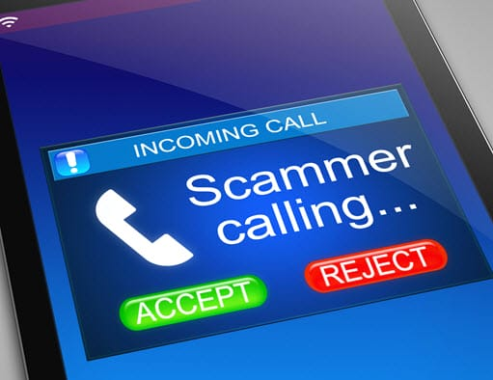
Recognizing online scams
Scammers are constantly finding new ways to trick people online, often by pretending to be someone trustworthy like a friend, family member, or even a well-known company. They may ask for personal details, money, or access to your accounts.

Slide 13
Recognizing online scams
Be cautious when clicking on unfamiliar links, especially in unsolicited emails, texts, or direct messages. Phishing scams often use urgent language, telling you to “act quickly” or claiming that “you’ve won a prize.” Always double-check the sender’s email address or the website URL before entering any sensitive information.

Slide 14

Social media privacy settings
Regularly review your privacy settings on platforms like Instagram, Snapchat, and TikTok to ensure you’re comfortable with who can see your posts, comments, and photos. Before posting anything, think about whether it’s something you’d want everyone to see forever—even after you’ve deleted it, copies of posts or photos might still exist online.

Slide 15
Social media privacy settings
Social media is a great way to stay connected with friends, but it’s important to take control of who can see what you post. Make sure your accounts are set to private so only people you trust can view your information. Public accounts can expose you to strangers, who might misuse your photos or messages.

Slide 16

Safe online gaming
Online gaming is a fun way to relax and connect with friends, but it also brings risks, especially when playing with strangers. Be careful about who you’re chatting with during games, as some people may not be who they say they are.

Slide 17
Safe online gaming
Stick to playing with friends you know in real life. If you choose to engage with others, never share personal details like your real name, age, or location. Use private chat settings and avoid sending or receiving photos or videos.
If someone makes you feel uncomfortable, report or block them immediately.

Slide 18

Avoiding inappropriate content
The internet contains a lot of inappropriate and harmful content, ranging from violent videos to adult material. It’s important to avoid sites or content that could negatively affect your mental health or expose you to illegal activities.

Slide 19
Avoiding inappropriate content
Use safe search filters and parental controls on devices to limit exposure to inappropriate content. If you accidentally stumble upon something that makes you uncomfortable, don’t hesitate to close the window or app and tell an adult. They can help guide you on what to do next.

Slide 20

talk to trusted adults
If you ever feel unsafe or uncomfortable about something that happens online, it’s important to talk to a trusted adult—whether that’s a parent, teacher, or counselor. Adults can offer advice, help report harmful behaviour, and take steps to protect you.

Slide 21
talk to trusted adults
You should never feel like you have to deal with online issues by yourself. Whether it’s cyberbullying, someone asking you for inappropriate pictures, or encountering dangerous content, don’t hesitate to reach out for help. The earlier you speak up, the better.

Slide 22

Conclusion & takeaways
The internet is a powerful tool, but like any tool, it must be used responsibly. By being cautious about what you share, recognizing online threats, and knowing when to ask for help, you can protect yourself and make the online world a safer place.

Slide 23
Conclusion & takeaways
Let’s commit to being smarter, kinder, and more responsible online. Whether you’re using social media, playing games, or doing schoolwork, make choices that keep you and others safe.
Together, we can create a positive online environment for everyone.

Slide 24
next steps
Each month, your tutor will discuss can aspect of online safety during tutor time and the presentations will be available to view online.

