Slide 1




Slide 2
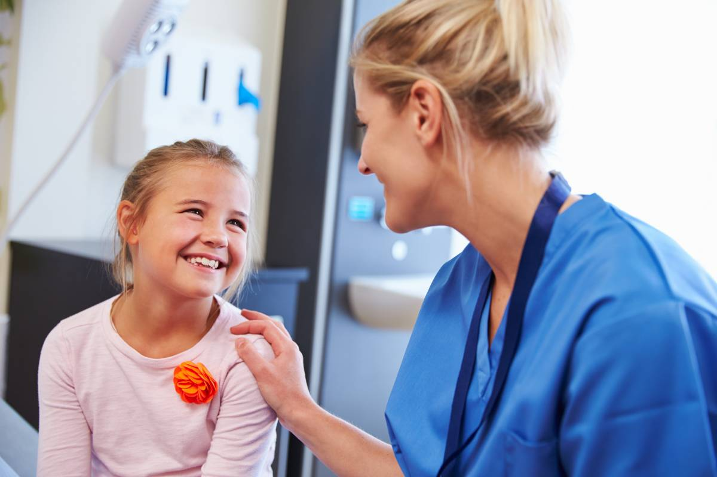
Who are we?
We are a team of nurses and administration assistants that provide Immunisations to children and young people in line with the national program.
The Immunisations we provide in schools are:
  Flu
  HPV (Human papillomavirus)
  Tetanus, Diphtheria, Polio (3 in 1)
  Meningitis ACWY
  Mumps, Measles and Rubella (MMR)

Slide 3
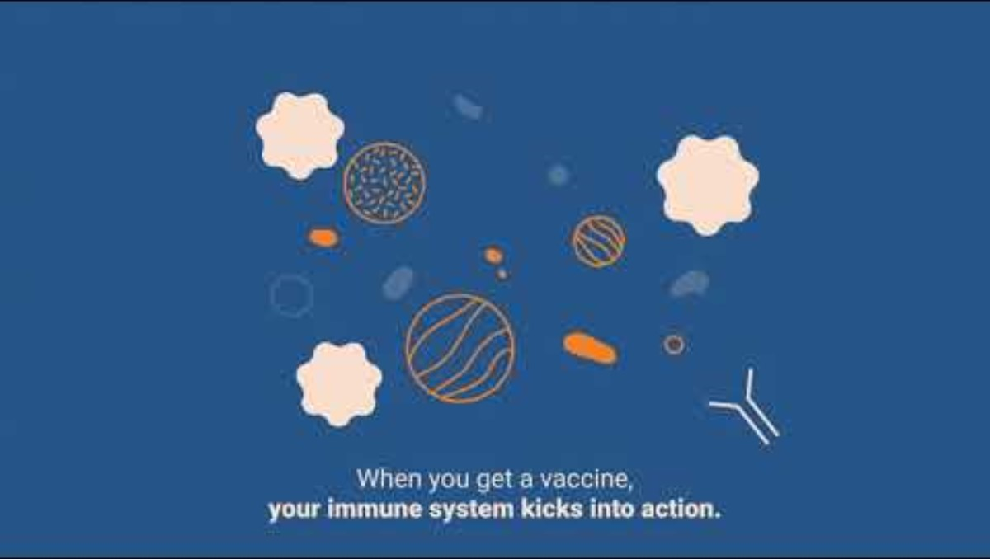
What do vaccines do?

Slide 4

Year 9 vaccines
In year 9 you will be offered 2 vaccines:
The diphtheria, tetanus and polio vaccine (3 in 1) This is a booster and boosts the protection you will have received from your baby/preschool Immunisations. Most people will have received 4 vaccines before they reached school age to protect them from these illnesses and require a booster in year 9.
A meningitis vaccine (MenACWY) - this helps protect against life-threatening illnesses like meningitis and sepsis. It's offered to teenagers in school - but can be given up to the age of 25 if it's been missed.
We also offer catch ups for children outstanding their HPV vaccine and MMR vaccines.

Slide 5
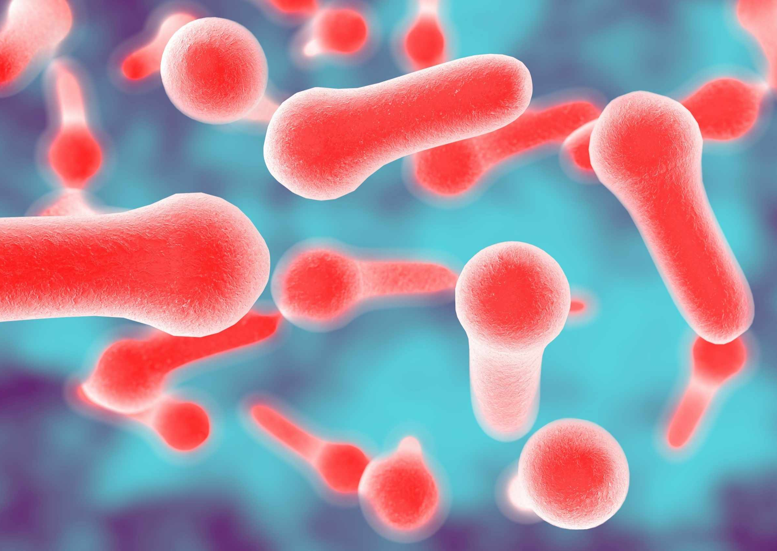
Tetanus
Tetanus is a serious, life-threatening condition.
There is a risk of tetanus if soil or manure containing bacteria gets into a wound, such as a bite, burn or scratch.
Tetanus is rare because the tetanus vaccine has been part of the routine vaccination schedule for many years - but the chances of getting it are higher if:
you have not been fully vaccinated (the tetanus vaccine has routinely been given since 1961)
you have a large or deep wound
the wound is very dirty or there is something stuck in the wound
Tetanus affects the nervous system and can cause symptoms such as muscle spasms, breathing difficulties, seizures and sometimes can lead to death.

Slide 6

Diphtheria
Diphtheria is a highly contagious infection that affects the nose and throat, and sometimes the skin.
It's rare in the UK, but there's a small risk of catching it if you travel to some parts of the world. Diphtheria can be a serious illness and sometimes fatal, especially in children, if it’s not treated quickly.
Diphtheria usually begins with a sore throat and can quickly cause breathing problems. It can damage the heart and nervous system and in severe cases, can kill.

Slide 7
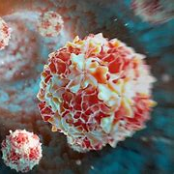
Polio
Polio is a severe disease that can be passed from person to person. Your chance of getting polio in the UK is extremely low. This is because most people are fully vaccinated.
There's still an extremely small risk of catching it when travelling in a country where polio is still found, such as Afghanistan and Pakistan, or through contact with a person when they return to the UK if you're not vaccinated.
Symptoms of polio include a high temperature, extreme tiredness, headaches, being sick, a stiff neck, muscle pain. In severe cases it can affect the brain and nerves, causing weakness or paralysis.

Slide 8
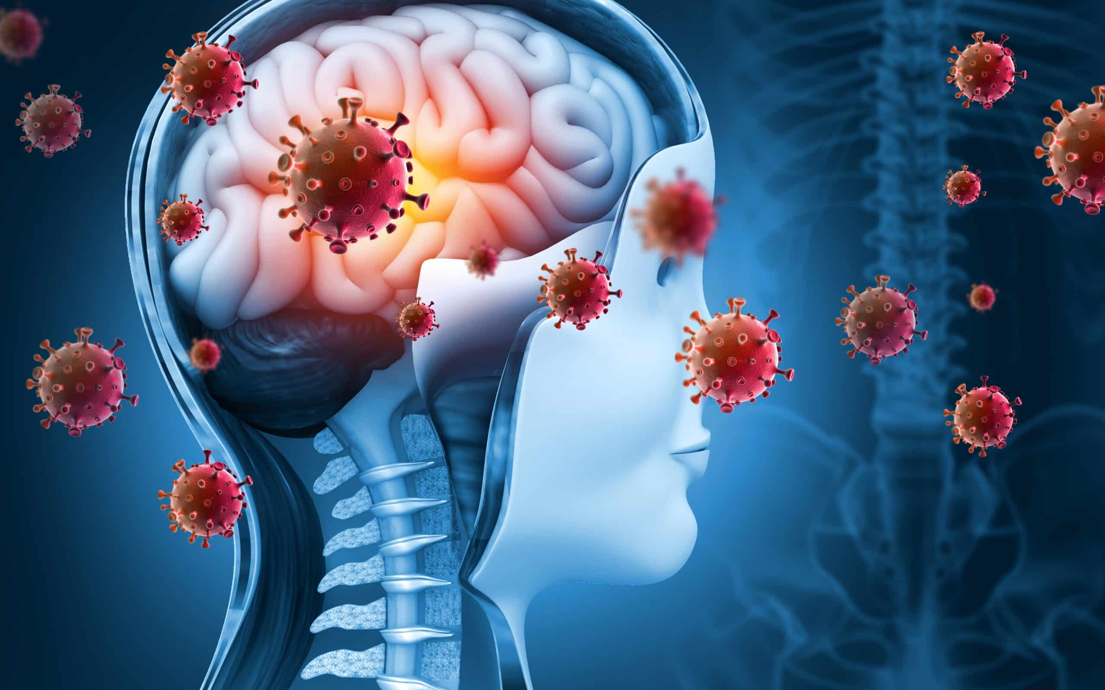
Meningitis ACWY

Slide 9

MenACWY
This vaccine protects against 4 types of bacteria linked to meningitis – A, C W and Y.
The MenACWY vaccine is given to teenagers. Anyone can get meningitis but it's most common in babies, children, teenagers and young adults. Meningitis is spread by close contact such as coughing, kissing or sneezing, and can spread very quickly in places like universities and colleges. Some people may unknowingly carry the meningococcal bacteria at the back of their nose and throat
Meningitis, sepsis and septicaemia (blood poisoning) are very serious, potentially life-threatening illnesses that can lead to life-changing disabilities, such as amputations, hearing loss and brain damage. Meningitis can start like a bad case of flu but then get worse very quickly. A rash can develop, along with a stiff neck. Early treatment can be lifesaving.

Slide 10

What are the potential side effects of the vaccines?
A reaction where the injection was given, such as pain, swelling or itchiness
A headache
feeling sick (nausea)/dizzy
a rash
feeling irritable
feeling drowsy
loss of appetite
Or generally feeling unwell
More serious side effects, such as a severe allergic reaction are very rare. The person who vaccinates you will be trained to deal with allergic reactions and treat them immediately.
The MenACWY vaccine and tetanus diphtheria polio vaccine used in the UK do not contain live bacteria, so there's no risk of getting the infections from the vaccine

Slide 11
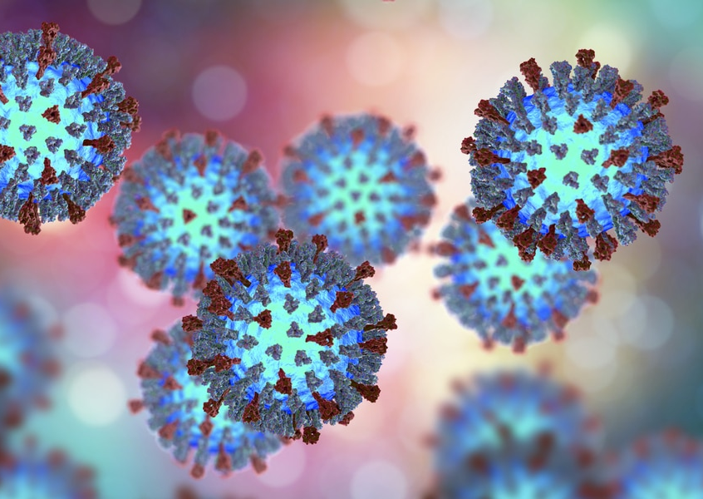
MMR catch up vaccines
The MMR vaccine protects against:
Measles
Mumps
Rubella (German measles)
These 3 infections spread easily between people and can lead to serious problems including meningitis, blindness and hearing loss.
Getting measles during pregnancy can cause premature birth, miscarriage or still birth. And getting rubella can cause serious problems for the baby such as damage to their sight and hearing.
2 doses of the MMR vaccine gives you long-term protection. Some people have missed one or 2 doses of the MMR vaccine given in childhood and require a catch-up dose. Please ask your parents if you received your MMR vaccines before you started school. If not you can contact us to book a catch up vaccine.
Getting vaccinated also helps protect people who cannot be vaccinated, such as unborn babies, newborn babies and anyone with a weakened immune system.

Slide 12

Prior to the session we will send a link home for parents to consent to the vaccines.
On the day of the session if your parent has not given consent we will attempt to contact them if you wish to consent to the vaccine
If we are unable to contact a parent/guardian we can assess you to see if you can self consent. This is known as being ‘Gillick Competent’

Slide 13

Gillick competence (Self consent)
Children under the age of 16 can consent to their own treatment if they're believed to have enough intelligence, competence and understanding to fully appreciate what's involved in their treatment. This applies to many aspects of healthcare including sexual and mental health services. Being competent to self consent is known as being ‘Gillick competent’ .
To be considered Gillick competent you must demonstrate:
You understand the immunisation being given
You understand what the immunisation is protecting you from
You understand the risks of not having the immunisation
You understand the potential side effects of the vaccines
You must also show you can retain the information and make an informed decision.
A nurse will discuss this with you on the day of vaccination if you wish to self-consent.

Slide 14

EMAIL: immunisations.nottinghamshire@intrahealth.co.uk
C O N T A C T N O :
0333 358 3397 option 4, option 2

