Slide 1

oS24: ONLINE SAFETY 2024

Slide 2

Empowering Parents: Keeping Your Child Safe in the Digital World
To provide practical tips and tools to protect your child online while encouraging responsible and healthy internet habits.

Slide 3
Empowering Parents: Keeping Your Child Safe in the Digital World
What percentage of teenagers encounter inappropriate content online?
30 % 50% 60% 70%

Slide 4
Empowering Parents: Keeping Your Child Safe in the Digital World
What percentage of parents use parental controls on their child's devices?
25 % 35% 45% 55%

Slide 5
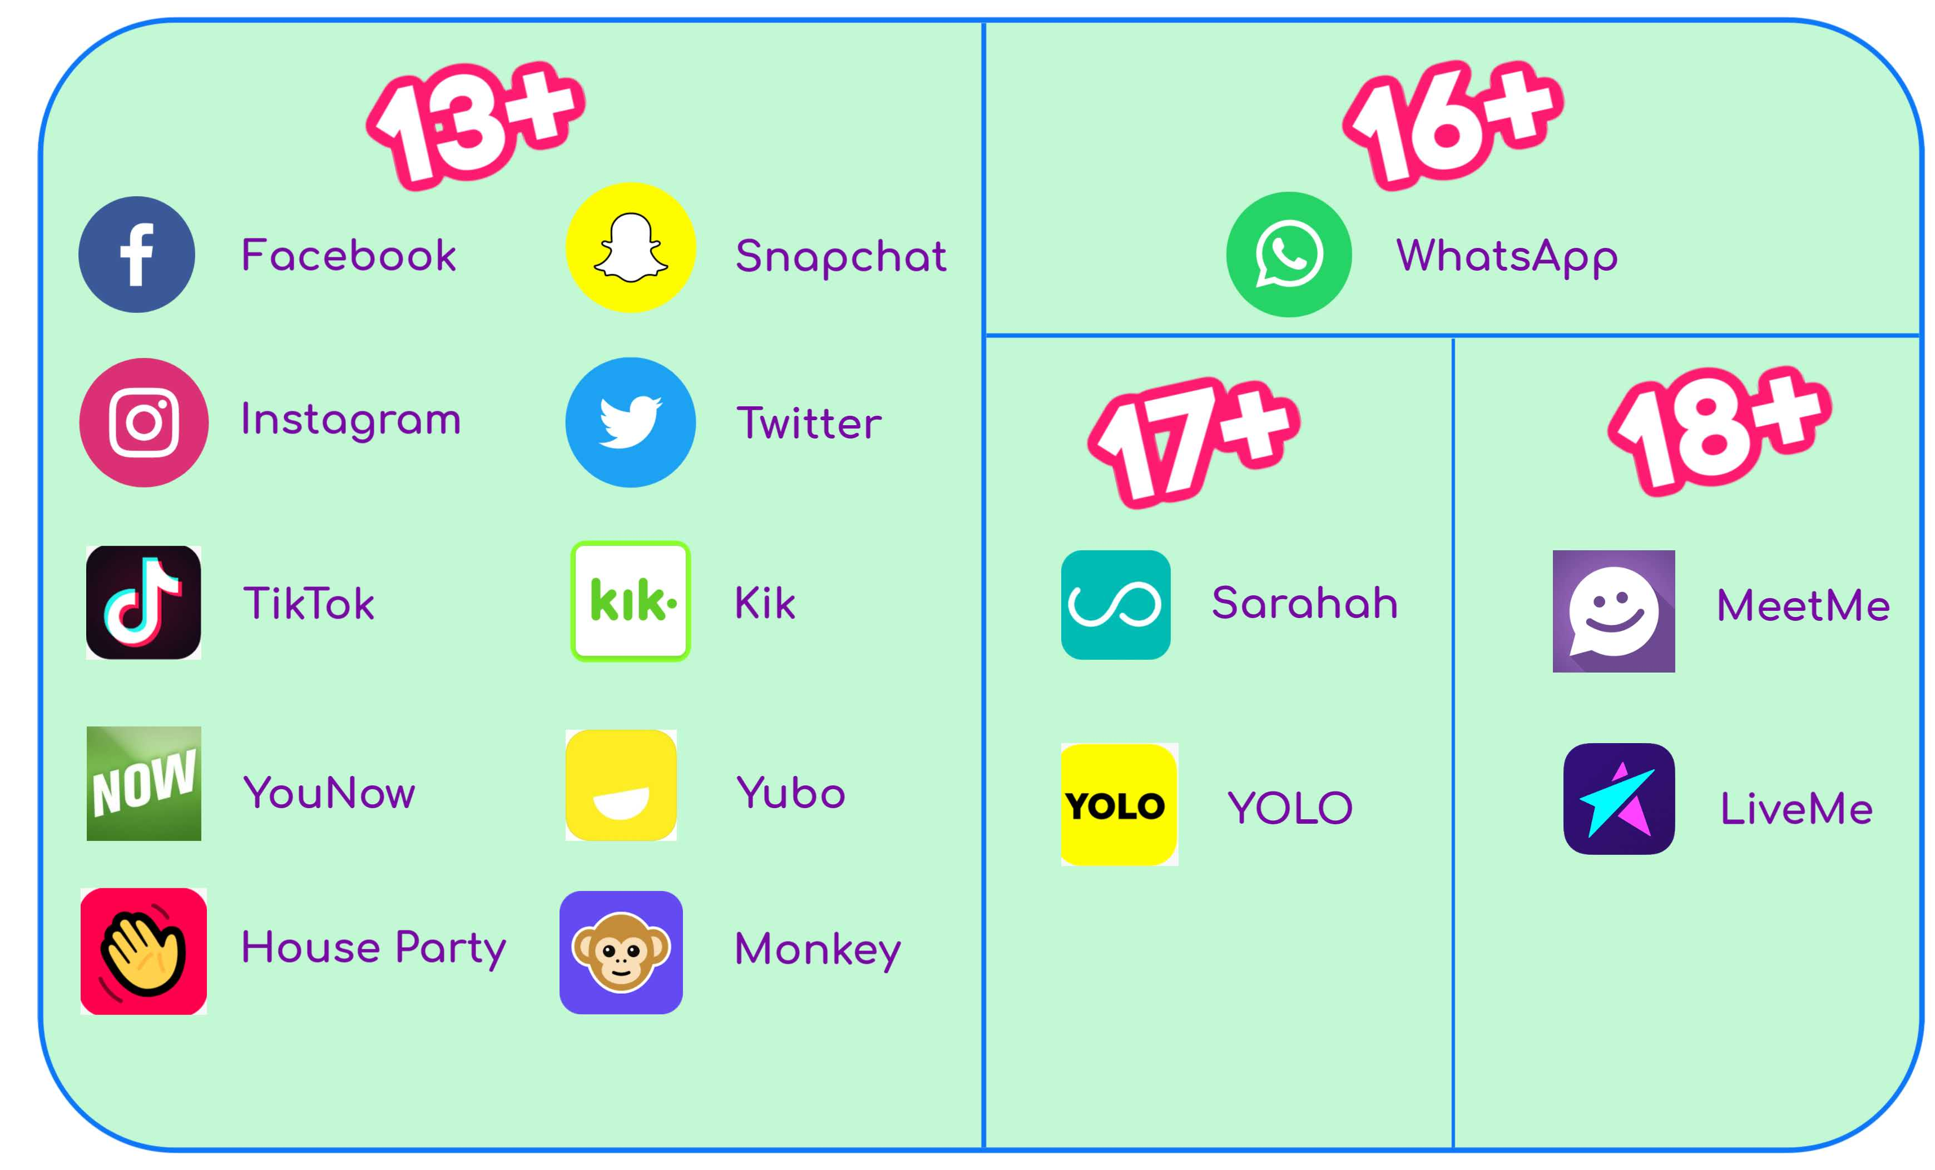
COMING OF AGE IN THE DIGITAL AGE
First phone
First time travelling to school alone
Wider friendship networks
On screen depictions of school life

Slide 6
The Risks Children Face Online
• Inappropriate content (violence, adult material, extremist views).
• Online predators.
• Cyberbullying.
• Excessive screen time and addiction.
• Privacy concerns (oversharing personal information)

Slide 7
Proactive Steps to Keep Kids Safe
Communication is Key
• Encourage open, judgment-free conversations.
• Teach children to recognize and report uncomfortable situations.
Set Clear Boundaries
• Establish rules for screen time, apps, and websites.
• Model healthy online habits as parents.

Slide 8
Proactive Steps to Keep Kids Safe
Use Technology Wisely
• Parental Controls: Use the built-in settings on devices or apps (e.g., YouTube Kids, Apple Screen Time, Google Family Link).
• Monitoring Tools: Tools like Qustodio help supervise without invading privacy.
Teach Online Safety Skills
• The importance of strong passwords and avoiding oversharing.
• Warn against clicking suspicious links or downloading unknown files.

Slide 9
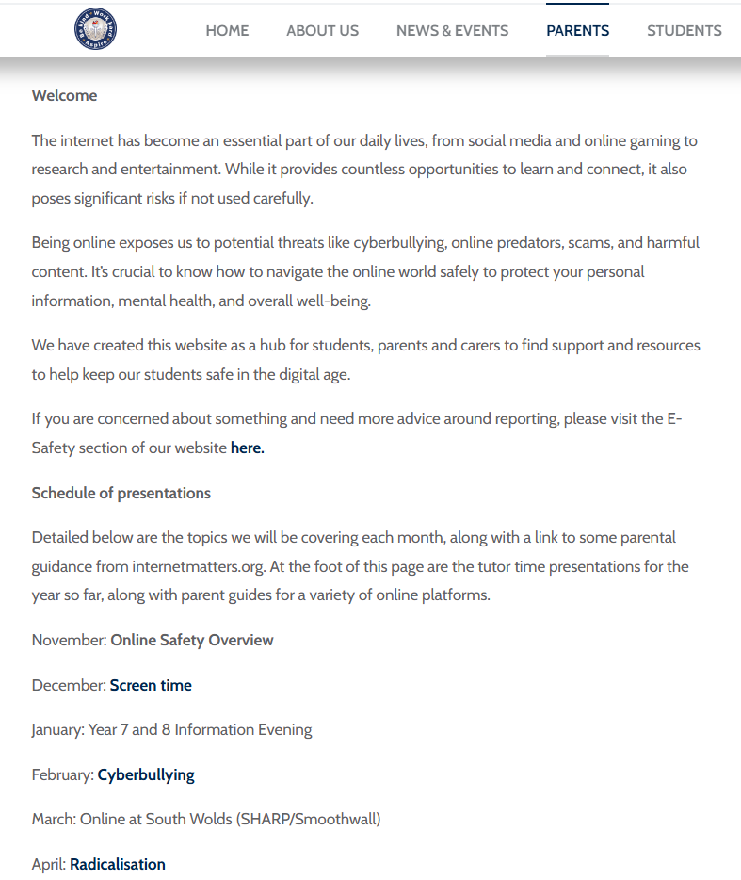
Resources for parents
We have added an ONLINE SAFETY HUB to our school website, accessible via the parent tab.

Slide 10
Resources for parents
Here you will find every presentation that your child has seen along with useful links to internetmatters.org and parent guides,

Slide 11
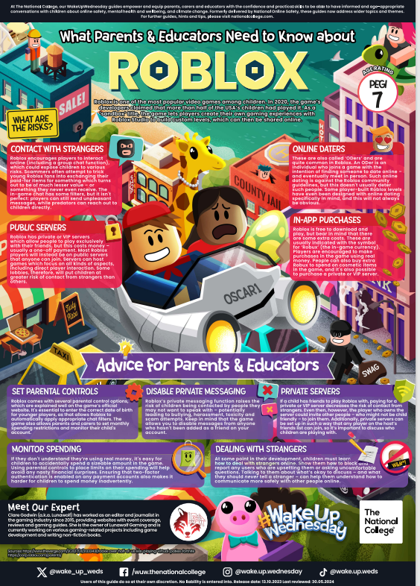
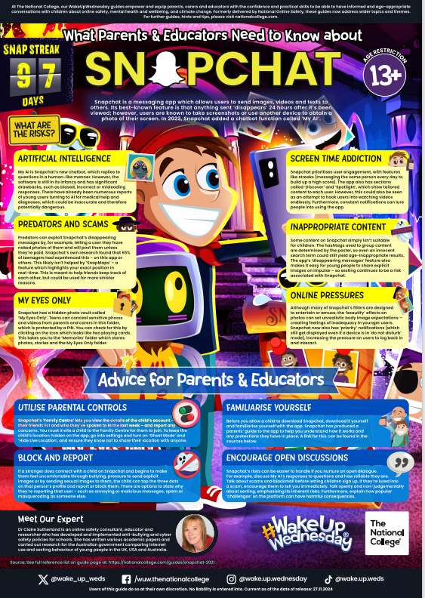
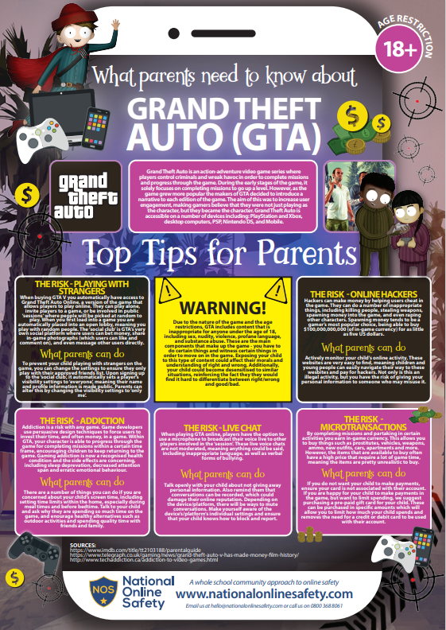
Resources for parents
Here you will find every presentation that your child has seen along with useful links to internetmatters.org and parent guides.

Slide 12
In summary
Communication/Mood changes
Boundaries/Screen Time
Tech tools/Parental settings
Safety skills/Password choices

